Slide 1
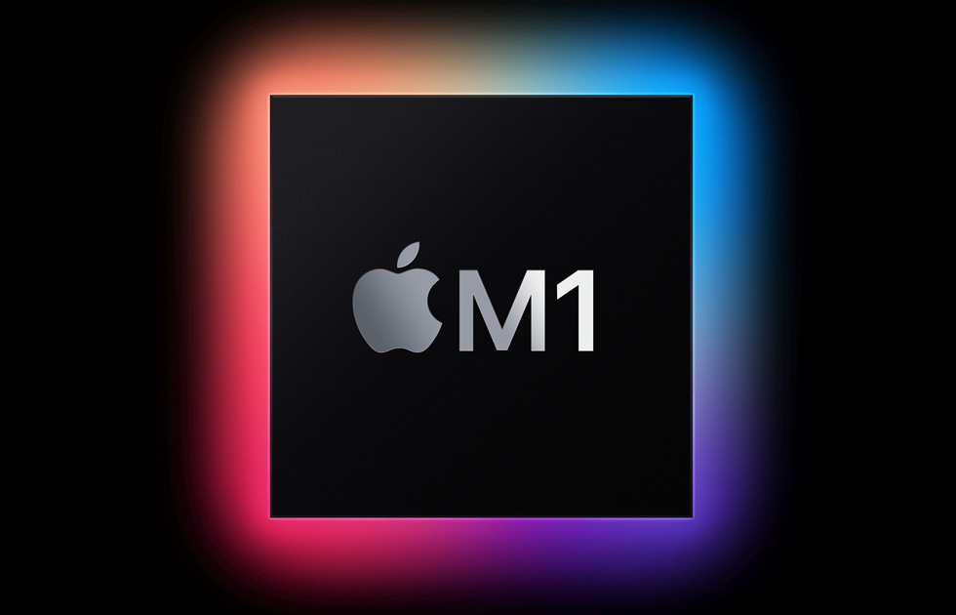

Slide 2
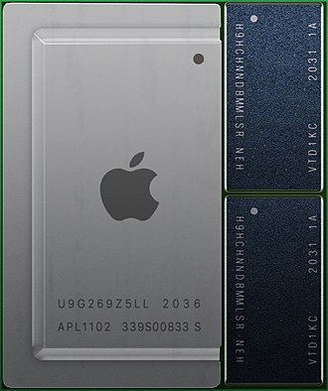
Apple M1 is a series of ARM-based systems-on-a-chip (SoCs) designed by Apple Inc. as a central processing unit (CPU) and graphics processing unit (GPU) for its Mac desktops and notebooks, and the iPad Pro and iPad Air tablets. The M1 was introduced in November 2020. The M1 was followed by the professional-focused M1 Pro and M1 Max chips in 2021. The M1 Max is a higher-powered version of the M1 Pro, with more GPU cores and memory bandwidth and a larger die size. Apple introduced the M1 Ultra in 2022, combining two M1 Max chips in one package. These chips differ largely in size and the number of functional units: for example, while the original M1 has about 16 billion transistors, the M1 Ultra has 114 billion. Apple's macOS and iPadOS operating systems both run on the M1. Initial support for the M1 SoC in the Linux kernel was released in version 5.13 on June 27, 2021.
Illustration of an M1 (APL1102) processor

Slide 3
CPU
The M1 has four high-performance "Firestorm" and four energy-efficient "Icestorm" cores, first seen on the A14 Bionic. It has a hybrid configuration similar to ARM DynamIQ and Intel's Lakefield, Alder Lake and Raptor Lake processors. This combination allows power-use optimizations not possible with previous Apple–Intel architecture devices. Apple claims the energy-efficient cores use one-tenth the power of the high-performance ones.

Slide 4
GPU
The M1 integrates an Apple designed eight-core (seven in some base models) graphics processing unit (GPU). Each GPU core is split into 16 Execution Units, which each contain eight Arithmetic Logic Units (ALUs). In total, the M1 GPU contains up to 128 Execution units or 1024 ALUs, which Apple says can execute up to 24,576 threads simultaneously and which have a maximum floating point (FP32) performance of 2.6 TFLOPs.

Slide 5
Memory
The M1 uses a 128-bit LPDDR4X SDRAM in a unified memory configuration shared by all the components of the processor. The SoC and RAM chips are mounted together in a system-in-a-package design. 8 GB and 16 GB configurations are available.

